Slide 1

Department of Computer Science & Engineering(AI&ML)
Project review on
SMART GLOVES
TEAM ID:662125-MI041
Guide: Mr.G.Venkateswarlu
Assistant Professor,
Dept. of CSE(AI&ML).
Presented by:
K.Priyanka(218R1A66G4)
M.Kavya(218R1A66G7)
M.Praveen Kumar(228R156616)
L.Dhrushyathi(228R5A6620)

Slide 2
ABSTRACT
The main objective of this project is to reduce communication barrier between normal people and special person who are not able to make a normal conversation be it a disabled one or dumb and deaf or paralysed.
As human Beings communicate and know each other through thoughts and ideas. The best way to present your idea is through speech.
But some people don’t have the power of speech; the only way to communicate with others is through their movements.
We can say that it is limited to the same set of persons that cannot speak. So, there is a need of technology which reduces this gap through systems that converts movement into speech.

Slide 3
INTRODUCTION
In the recent years there has been a rapid increase in the number of hearing impaired and speech disabled victims due to birth defects, oral diseases and accidents.
When a speech impaired person speaks to a normal person, the normal person find it difficult to understand and asks the deaf-dumb person to show geasures for their needs.
Dumb person have their own language to communicate with us; the only thing is that we need to understand their language. The language used by the deaf people for their communication is known as sign language.
Here we propose a smart speaking system that helps mute people in conveying the message to regular people using hand motions or gestures.
The main aim of this paper is to facilitate people by means of a glove based communication interpreter system.

Slide 4
LITERATURE SURVEY
Hand gesture recognition and voice conversion system for dumb people in our country around 2.78% of peoples are not able to speak (dumb). Their communications with others are only using the motion of their hands and expressions.
The main purpose of this smart gloves paper is to reduce this connection barrier. The key goal of the proposed plan is to design a cost-effective device that can give voice to a voiceless individual with the help of Smart Gloves.
This ensures that the use of smart gloves would not drive a wedge for two separate communities. This system must a dream come true for dumb and deaf people to interact normally with people without seeking other‘s help.

Slide 5
EXISTING SYSTEM
Since beginning in 2003, the Microsoft Imagine Cup has tasked students the world over with developing technology aimed at solving real-world problems.
Students were asked to build their project around a specific Millennium Development Goal (MDG).
However, with sign language varying greatly around the world, the users can teach the system new gestures and modify existing ones.

Slide 6
EXISTING SYSTEM LIMITATIONS
In existing system, there is no circuit to announce the thoughts of physically challenged peoples.
And gesture-based papers or circuits are not available in markets.
In olden days it is sign language, it cannot be understood by all the people for communication. There after a circuit is developed to mimic predetermined postures and match them with deaf & dump peoples sign language.

Slide 7
PROPOSED SYSTEM
The movement translator that we are going to developed uses a glove fitted with sensors that can interpret the movements of paralysed and deaf person.
The glove uses Flex sensors, ESP32, Accelerometer, Gesture recognition system, GSM Module, Arduino IDE, to gather data on each finger's position and the hand's motion to differentiate the movements.

Slide 8
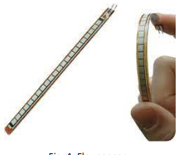
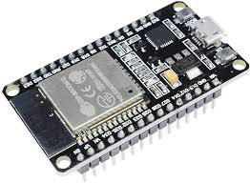
HARDWARE REQUIREMENTS:
Flex Sensors
ESP32

Slide 9
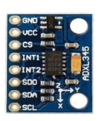
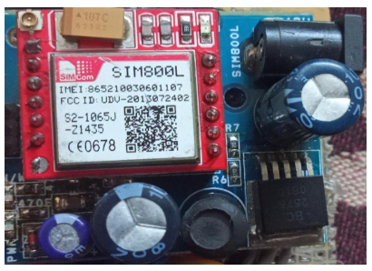
Accelerometer
Gesture recognition system
Voice section
GSM Module

Slide 10
SOFTWARE REQUIREMENTS:
Arduino IDE
Customised app
Words used

Slide 11
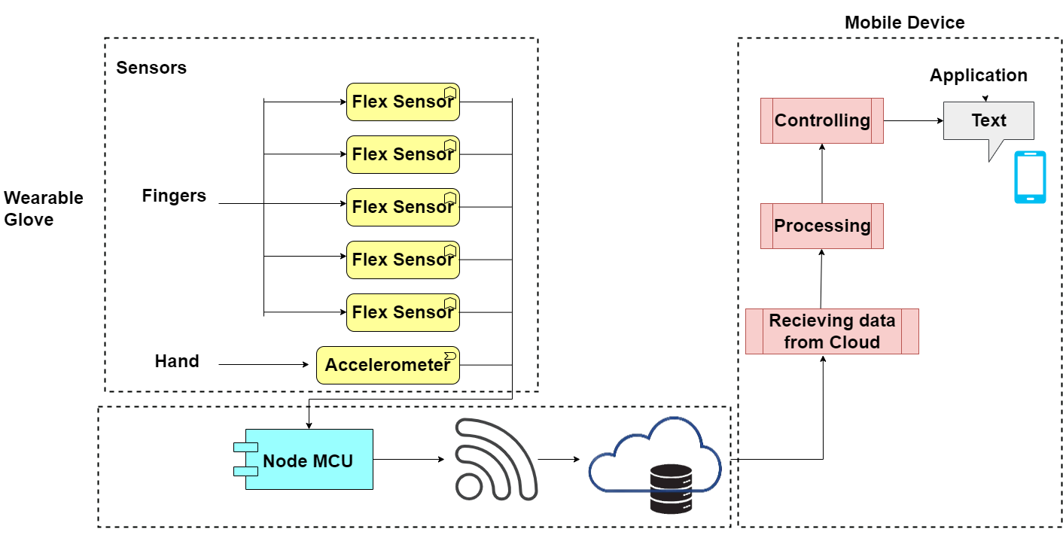
System architecture:

Slide 12
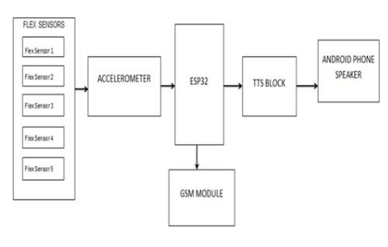
Data flow diagram:

Slide 13
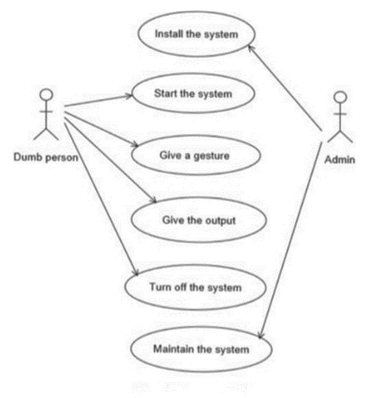
Use Case Diagram:

Slide 14
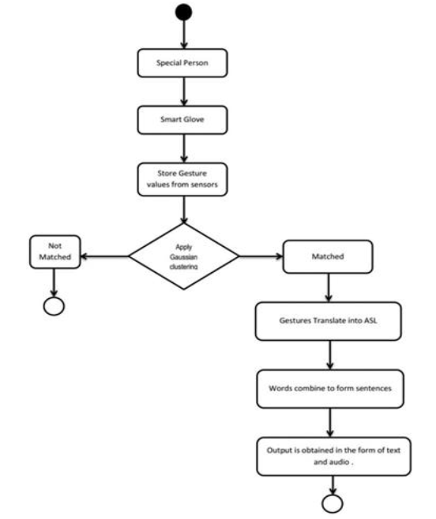
Activity Flow Diagram:

Slide 15
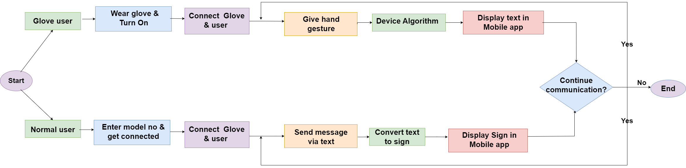
Overall Control Flow

Slide 16
Conclusion:
A disabled person communicates with others via sign language. The translation of sign language into text and spoken is done so that communication between them is not restricted. The barrier between disable peoples is broken down by using smart gloves for communication. Using smart gloves, disabled people may advance in their careers, which helps the country flourish because the number of disabled people is now in the millions.
In comparison to previous proposed systems, this system is more dependable, efficient, easy to use, and a light weight option for the user. This bridges the barrier between speech impaired people and others.
This technology will enable persons who are unable to communicate verbally by allowing them to express themselves through gestures. Depending on the user, the speech output can be changed to any language

Slide 17
Future Enhancement:
Since we only used few signs in this prototype, It believes that additional gestures might be used to detect entire sign language.
A convenient and portable hardware gadget with gloves may be
made so that a deaf and dumb person can converse with any normal person, anyplace.
This gadget has automation applications that can be developed in the future.

